Slide 1
Dual-Fisheye capturing, stitching, and rendering 360-degree photos.
PSYCH221 Final Project
Jacob Lange
lanjak11@Stanford.edu

Slide 2
A tour of 360-degree photos
Use cases
Capturing
Standard cameras, custom built poly capture devices, dual-fisheye cameras
Stitching
Challenges for different capture methods
In-depth look at dual-fisheye to equirectangular pipeline
Rendering
Displaying an equirectangular projection for end user consumption
Notes:
Use cases: Why do we care about 360 photos?
Capturing: Standard cameras & lens, Dual-fisheye cameras, custom built poly capture devices.
Stitching: Challenges for outputting a 360 degree equirectangular projection.
Rendering: How do we display these images for end user consumption.

Slide 3
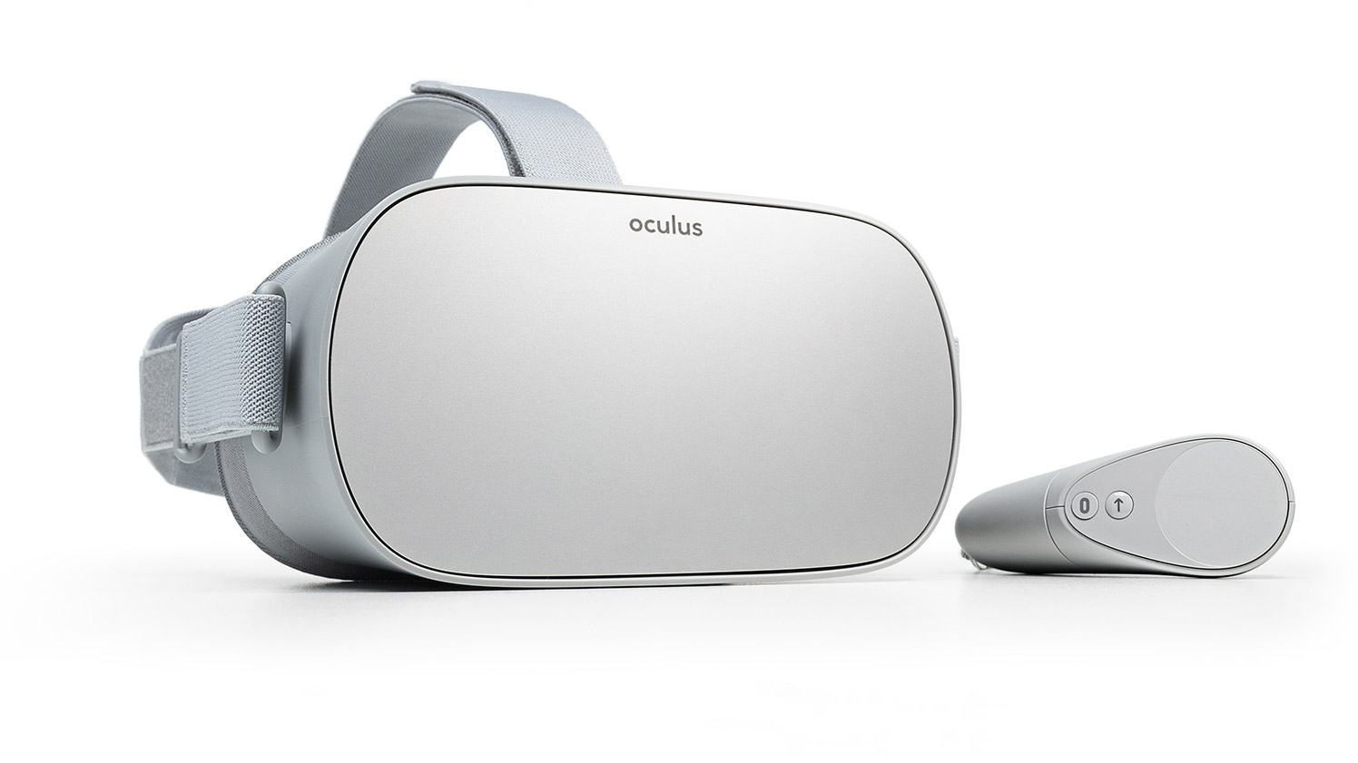
Use cases
Virtual reality and immersive imaging
An explosion in research, development, and commercialization of VR headsets has led to an interest in efficient capture and displaying of 360-degree photography.
Oculus Go
Notes:
Oculus Go is branded as a “all-in-one headset made for entertainment”. Video is increasingly popular on these devices. Facebook/Oculus deserves credit for advancing the technology behind 360-degree video capture.

Slide 4
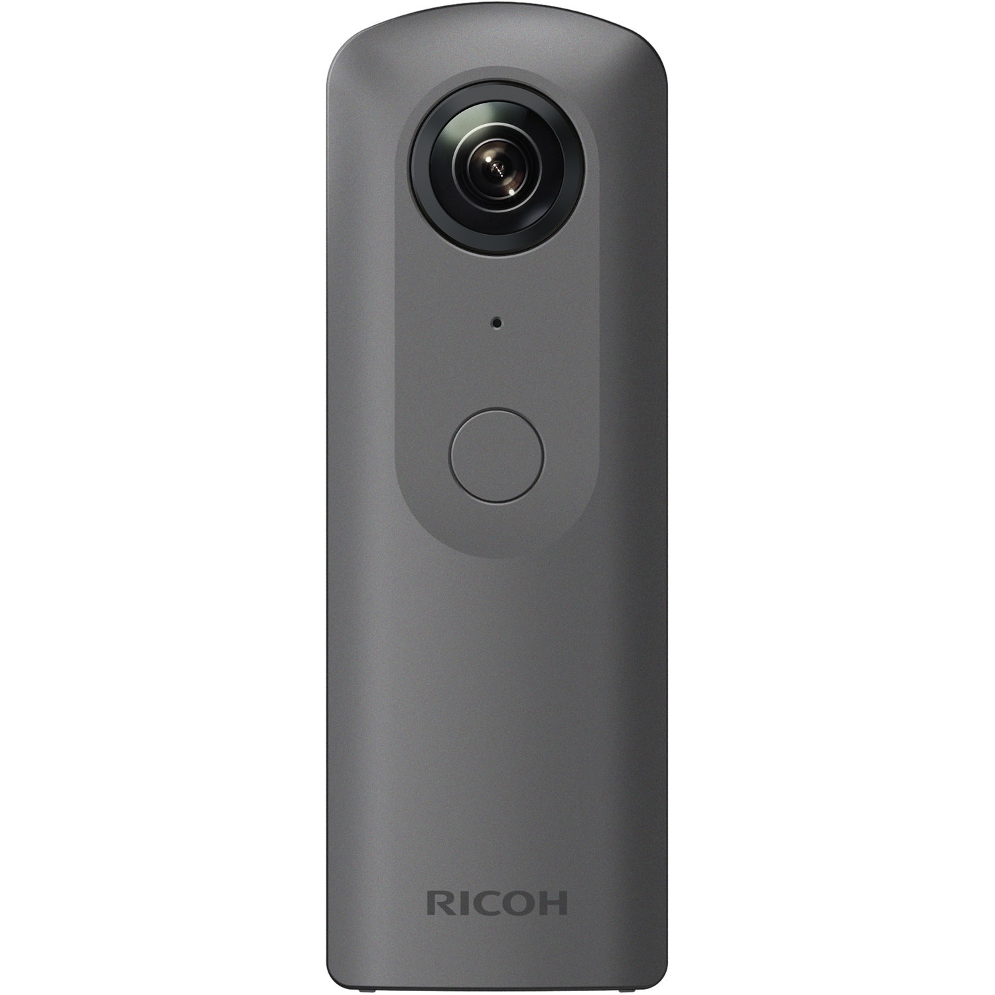
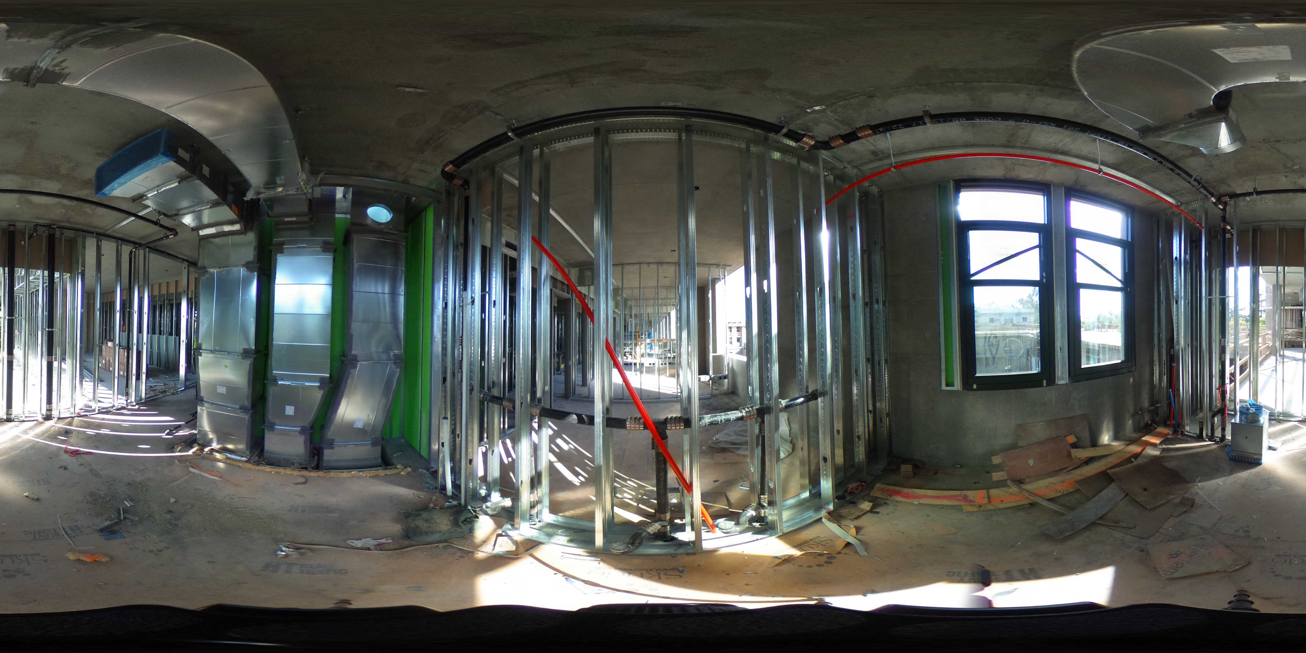
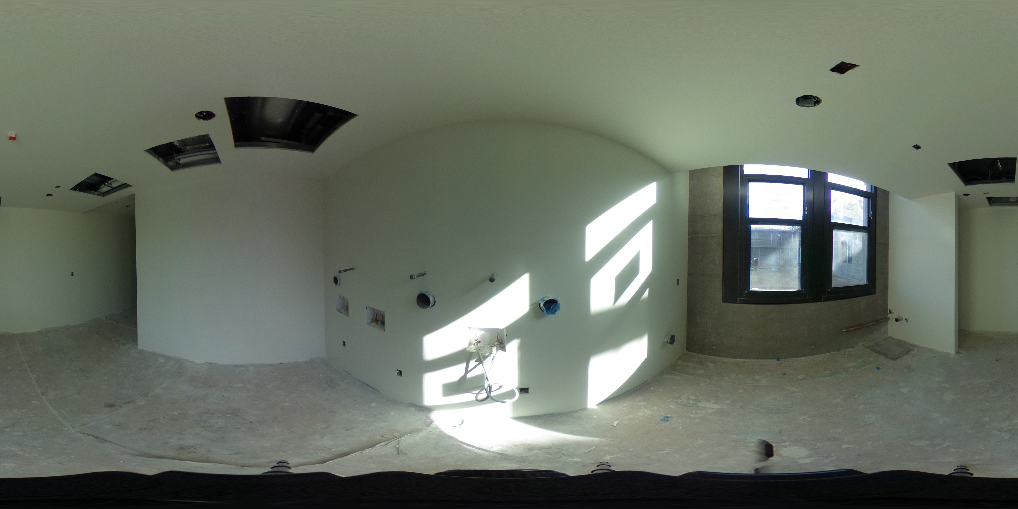
Use cases
Architecture, Engineering, and Construction (AEC).
An industry motivated to innovate, ease of capture has allowed for intriguing workflows that utilize the visualization power of 360-degree photography. Largely driven by the ease of capture of dual-fisheye cameras.
360-degree photos are being utilized for visualization, documentation, issue tracking, x-ray, and time-lapse of construction projects.
Ricoh Theta
Notes:
Some companies building entire products around these photos, e.g. StructionSite.

Slide 5
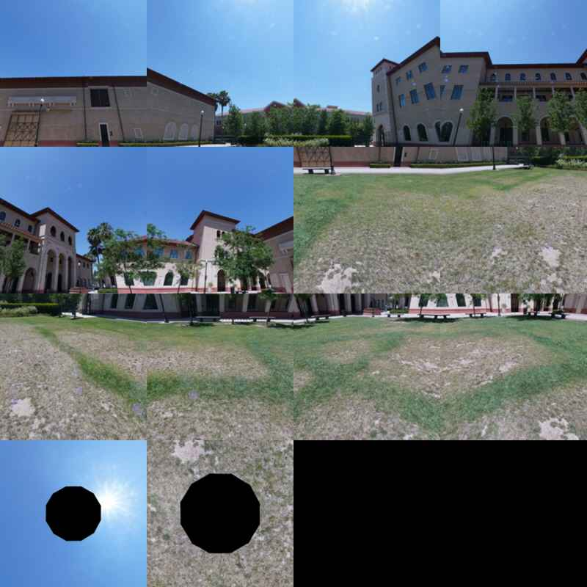
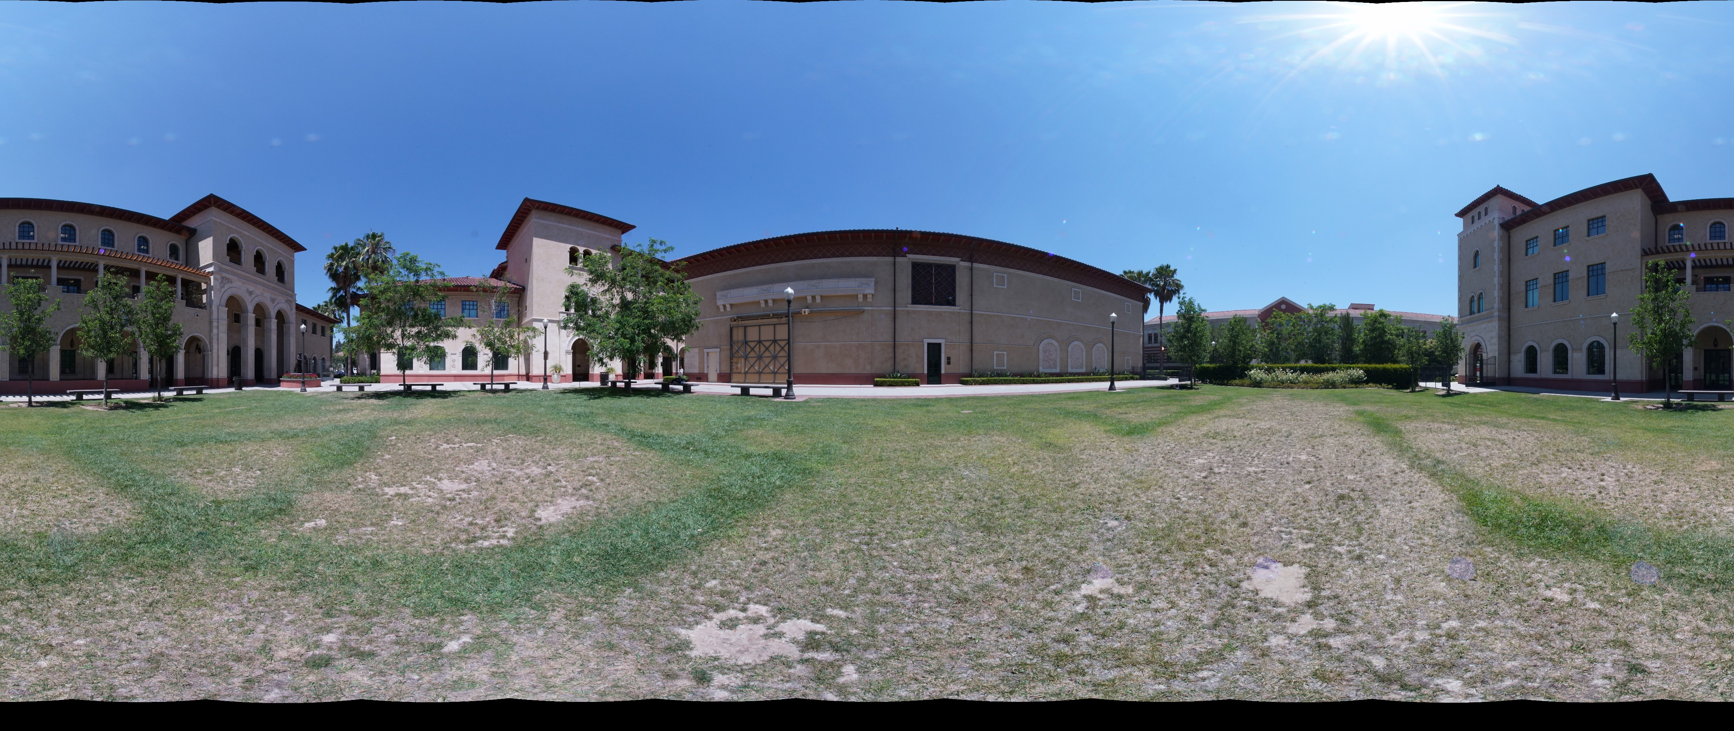
Capturing
Standard cameras and lens
Shown here is an example that uses:
1. Sony A7Rii Camera
2. 12mm fisheye lens
3. 360-degree Full Spherical Camera QTVR Tripod
4. Stitched by PTGUI
Notes:
Advantages:
Very high resolution and quality.
Disadvantages:
Requires manual capture – prior knowledge to exactly positions you need to capture.
Difficult to stitch, must properly deal with parallax error.
Requires commercial software to stitch with quality.
Photo credit: Eric Guizzetti USC

Slide 6
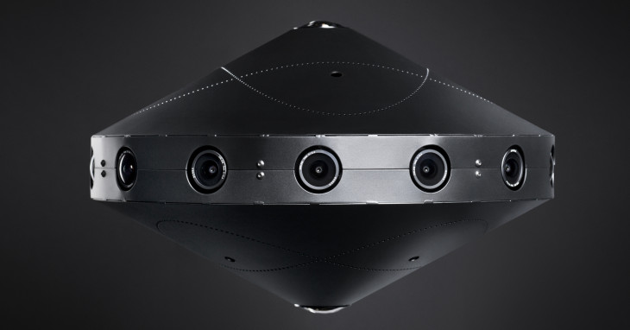
Capturing
Custom build poly capture hardware
High-quality, production-ready 3D-360 devices. Up to 8k resolution per eye in VR.
Facebook surround 360
Notes:
Facebook has entire suite of hardware, software, streaming solutions for 360-degree video.
https://engineering.fb.com/video-engineering/introducing-facebook-surround-360-an-open-high-quality-3d-360-video-capture-system/

Slide 7
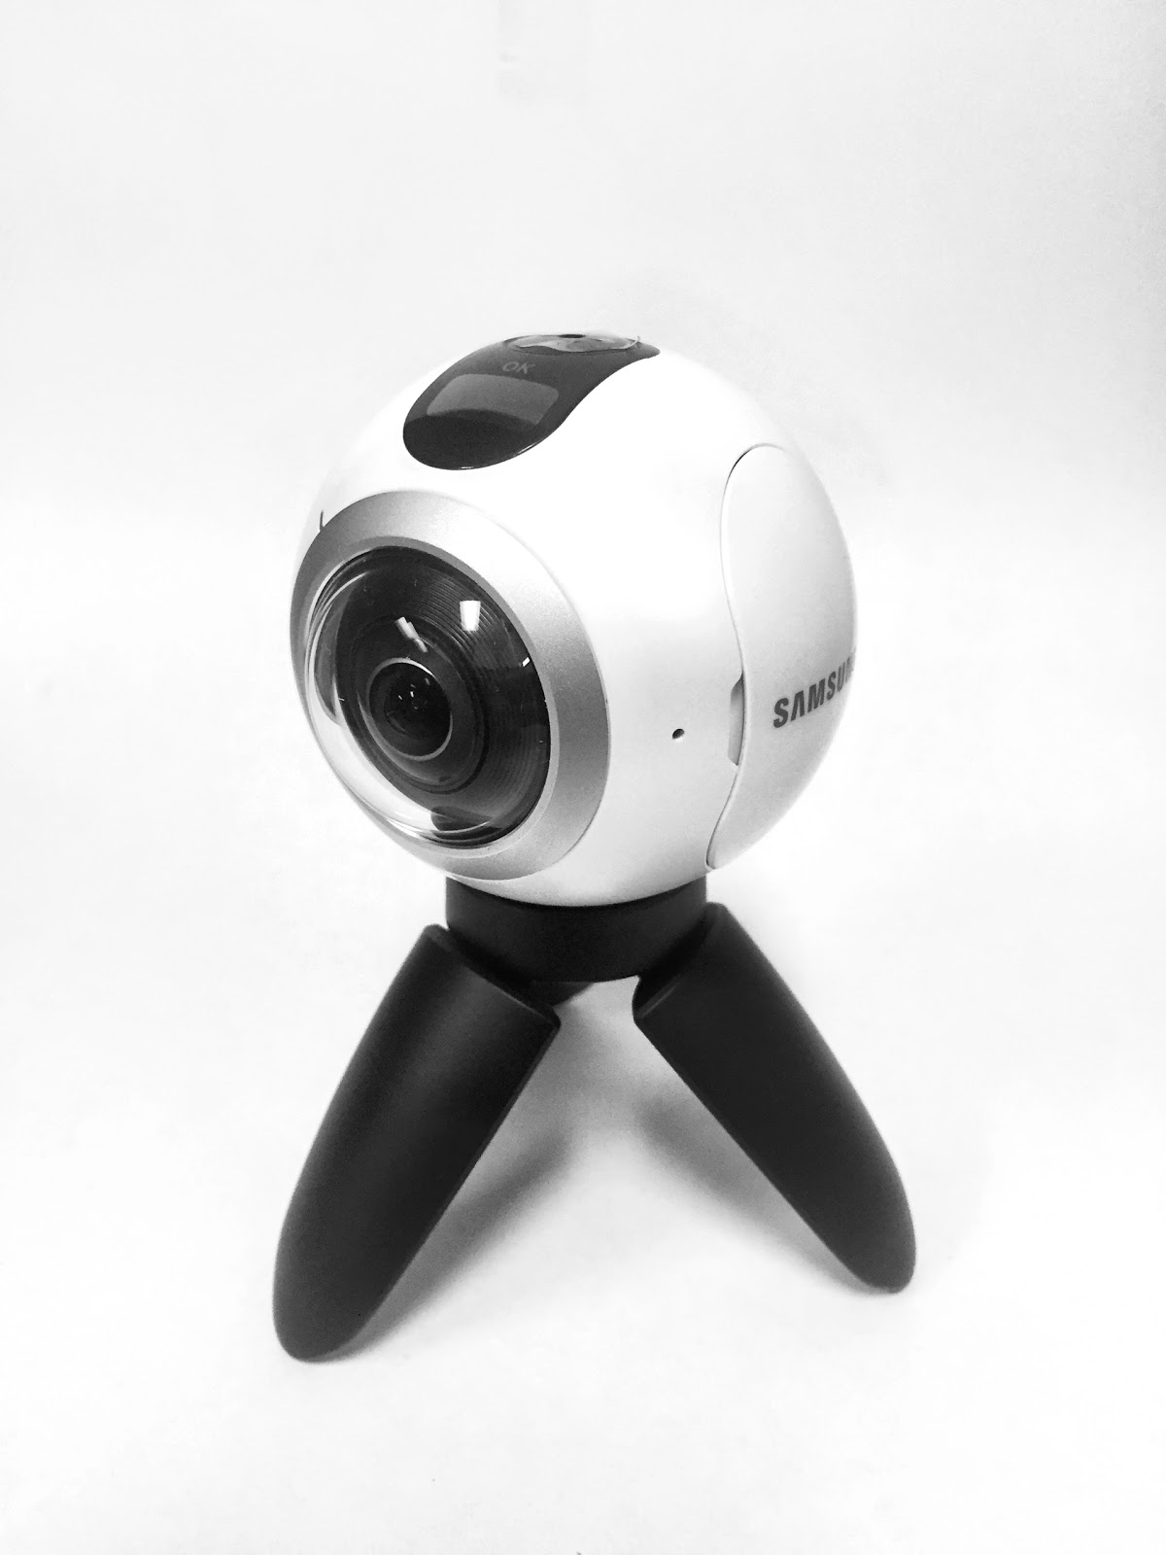
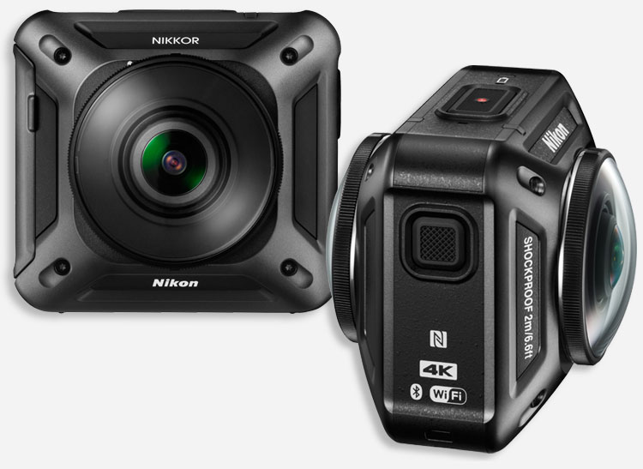
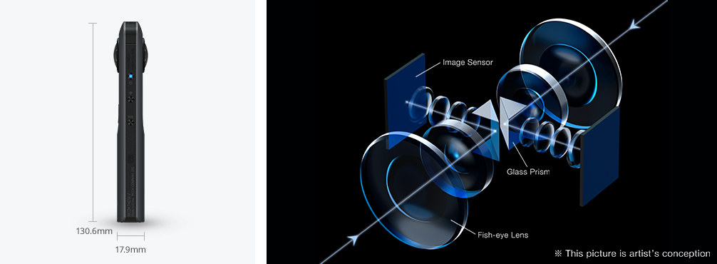
Capturing
Dual-Fisheye Cameras
A number of camera makers have produced multiple generations of dual-fish eye cameras. My project focuses on the Ricoh Theta S which features the following specs:
2x 1/ 2.3 12M CMOS sensor
2x F/2.0 Lens
Still image resolution up to 5376 x 2688
Video resolution up to 1920 x 1080 @ 30 FPS
Ricoh Theta
Samsung Gear 360
Nikon Keymission 360
Notes:
Note the alignment axis of the lens.

Slide 8
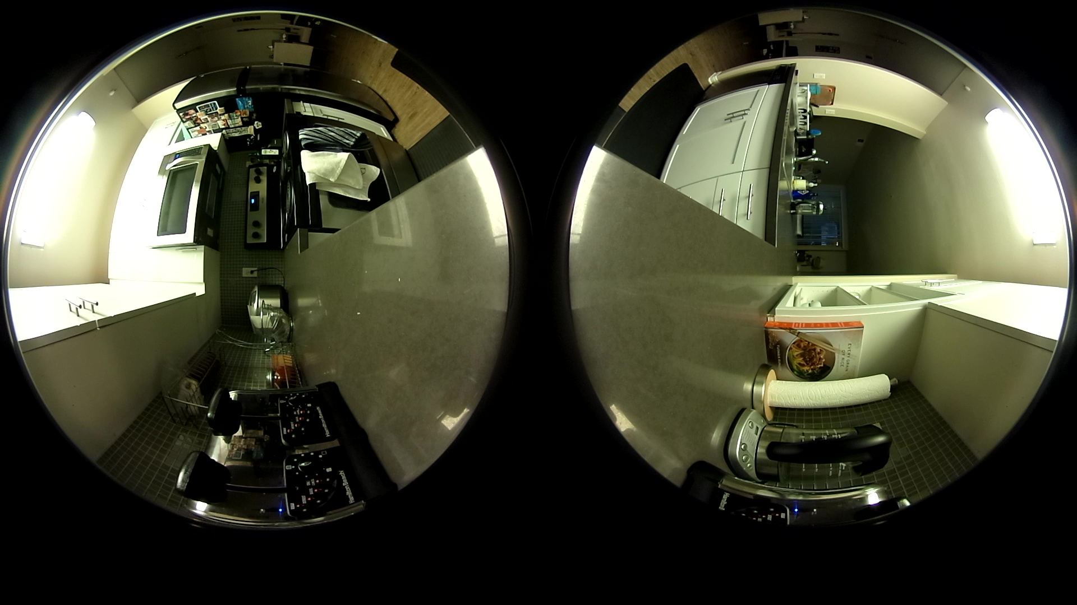
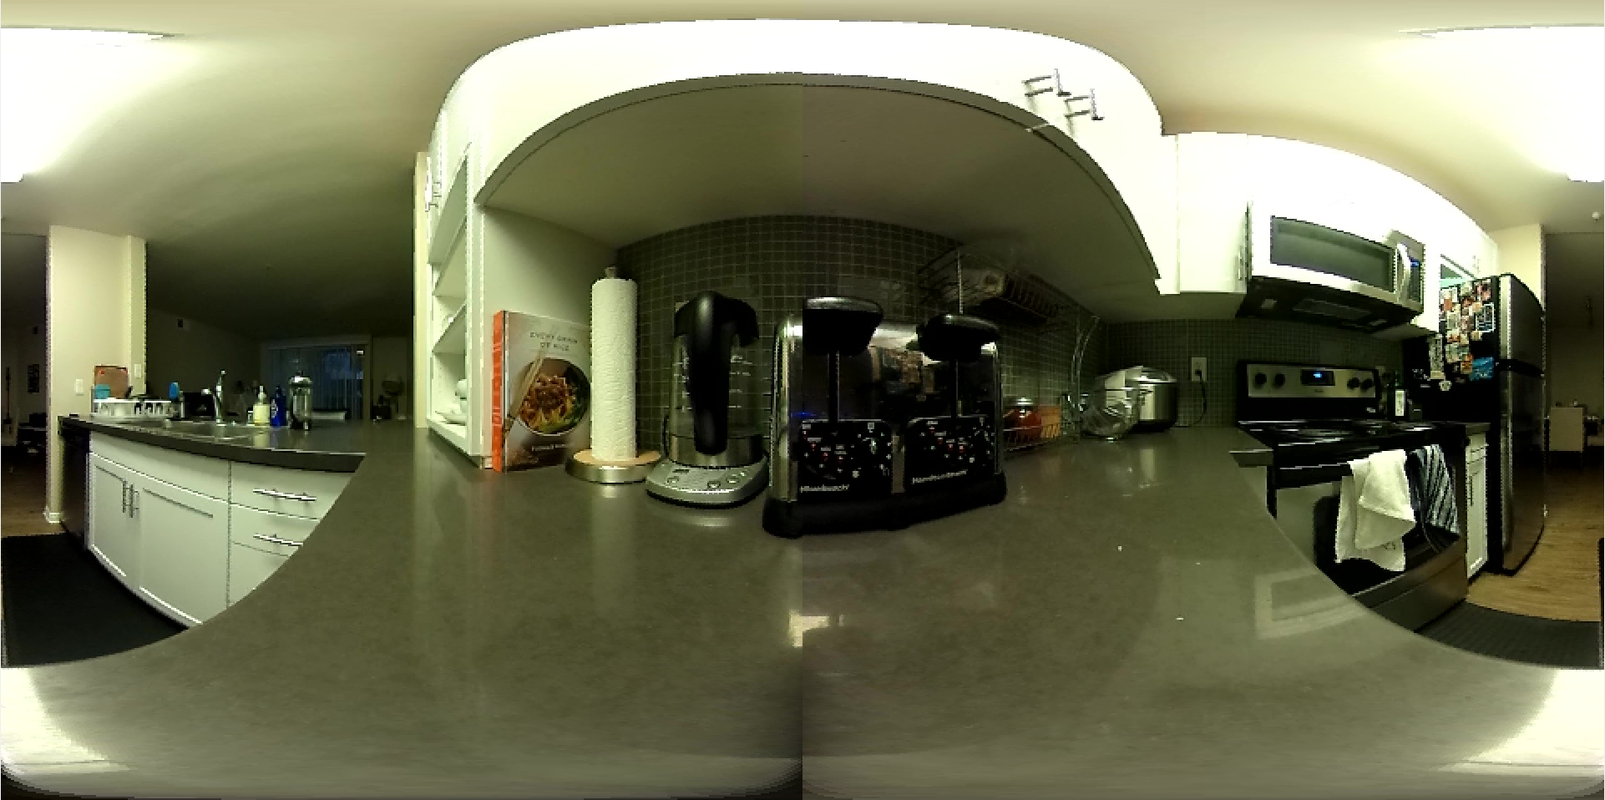
Stitching
Dual-Fisheye to equirectangular projection
The following slides describe a purely geometric approach to creating an equirectangular photo from two raw fisheye photos.
There is an alternative approach that utilizes feature points to find the overlapping regions before warping and blending.
Notes:
Note that I’m reliant on video so I’m limited to 1920x1080 resolution of raw capture, much less for equirectangular space since each image is up sampled.

Slide 9
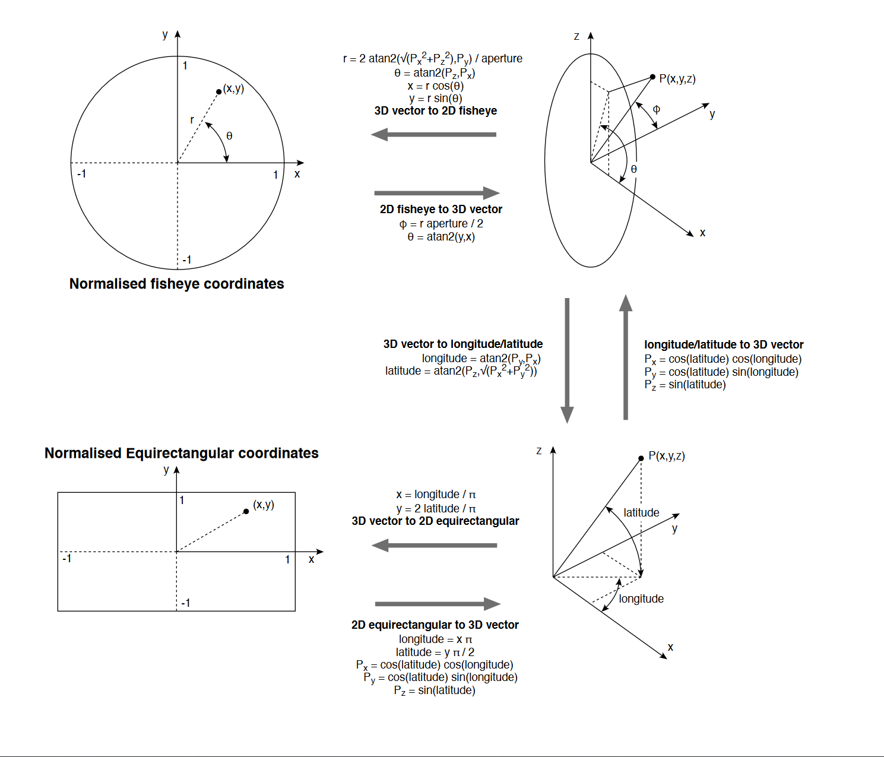
Stitching
Projecting fisheye to equirectangular space
The follow steps must be applied to each fisheye.
Create the output image at the proper size
Foreach pixel in output image
Map the x, y to the normalized equirectangular coordinate space
Calculate the longitude and latitude
Calculate a 3D vector from longitude/latitude
Project 3D vector to unit circle radius and angle
Compensate for rotation of fisheye
De-normalize unit circle point to location in source fish eye image
Copy pixel color from source image to destination x, y
Credit: http://paulbourke.net/dome/dualfish2sphere/

Slide 10
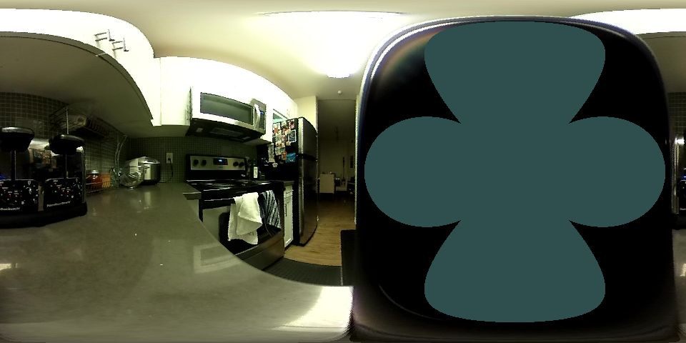
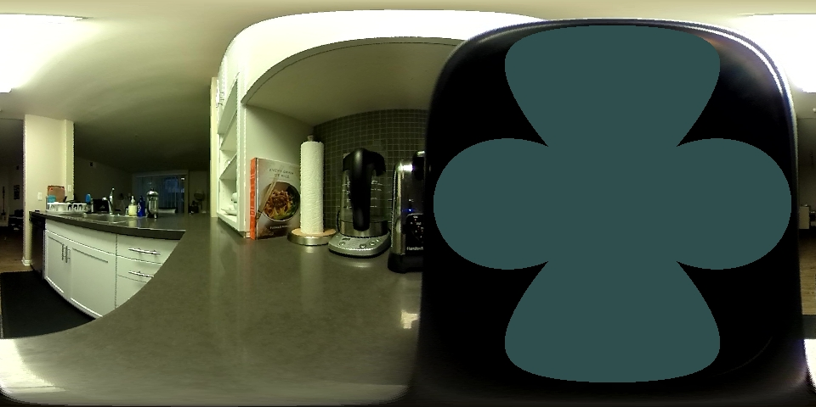
Stitching
Output from previous step

Slide 11
Stitching
Composing and blending into a single projection
The final step to produce an equirectangular projection ready for rendering is to crop and compose the images into a single projection. This produces a visible seam (shown here) that can blended with an alpha gradient to mask it’s appearance.
Notes:
These images will not align unless you provide the algorithm with the proper aperture angle.

Slide 12
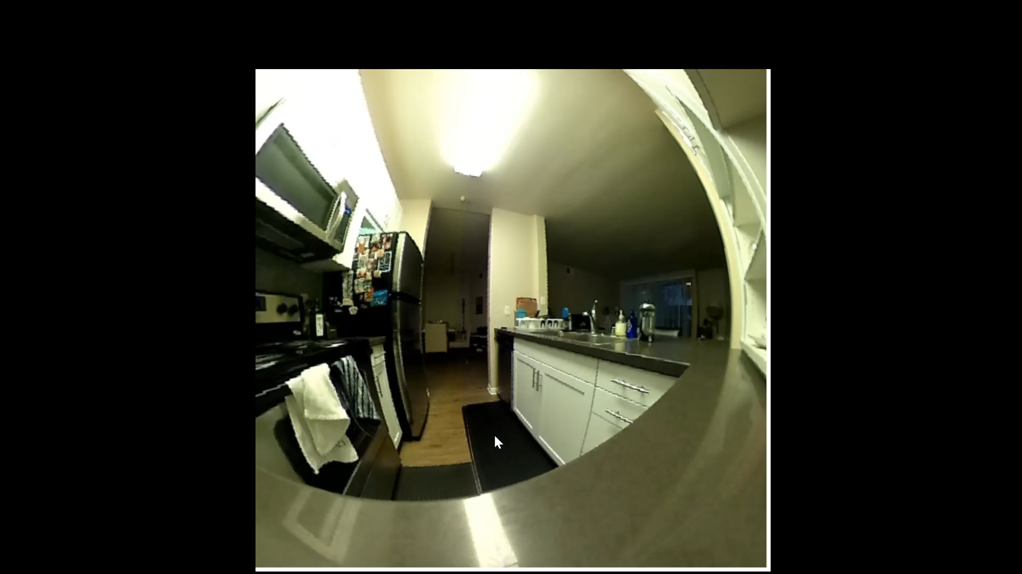
Rendering
From 2D image to interactive 3D view
Shown here is an example using OpenGL to display these images as an interactive 3D view.
The steps are simple:
Construction a spherical mesh object
Calculate proper UV coordinates, especially at the poles of the mesh
Load the mesh for rendering in OpenGL vertex buffers
Wrap the 2D equirectangular projection around the mesh object using shaders
Enable back face culling

Slide 13
Future work
A pipeline for capturing, stitching, and rendering of 360-degree videos. [1]
Implementation of more advanced alignment and parallax error correction.[1] [2]
Utilizing cube mapping to avoid redundant data in the equirectangular projection (important for high resolution video storage). [3]
Automatic parameter optimization for dual-fish photos. [4]
[1] https://ieeexplore-ieee-org.stanford.idm.oclc.org/document/8296241
[2] https://ieeexplore-ieee-org.stanford.idm.oclc.org/document/8614344
[3] https://engineering.fb.com/video-engineering/under-the-hood-building-360-video/
[4] http://paulbourke.net/dome/dualfish2sphere/

